Slide 2
Antra SEP Program
ASP.NET Core

Slide 3
Overview
ASP.NET Core is an open source and cloud-optimized web framework for developing modern web applications.
ASP.NET Core apps can run on .NET Core or on the full .NET Framework.
It was architected to provide an optimized development framework for apps that are deployed to the cloud or run on-premises.
It consists of modular components with minimal overhead, so you retain flexibility while constructing your solutions.
You can develop and run your ASP.NET Core apps cross-platform on Windows, Mac and Linux.

Slide 4
Benefits of ASP.NET Core
A unified story for building web UI and web APIs.
Architected for testability.
Razor Pages makes coding page-focused scenarios easier and more productive.
Ability to develop and run on Windows, macOS, and Linux.
Open-source and community-focused.
Integration of modern, client-side frameworks and development workflows.
A cloud-ready, environment-based configuration system.
Built-in dependency injection.
A lightweight, high-performance, and modular HTTP request pipeline.
Ability to host on IIS, Nginx, Apache, Docker, or self-host in your own process.
Side-by-side app versioning when targeting .NET Core.
Tooling that simplifies modern web development.

Slide 5
ASP.NET Core VS ASP.NET 4.x
ASP.NET Core | ASP.NET 4.x
Build for Windows, macOS, or Linux | Build for Windows
Razor Pages is the recommended approach to create a Web UI as of ASP.NET Core 2.x. See also MVC, Web API, and SignalR. | Use Web Forms, SignalR, MVC, Web API, WebHooks, or Web Pages
Multiple versions per machine | One version per machine
Develop with Visual Studio, Visual Studio for Mac, or Visual Studio Code using C# or F# | Develop with Visual Studio using C#, VB, or F#
Higher performance than ASP.NET 4.x | Good performance

Slide 6
What’s new in ASP.NET Core 2.2
ASP.NET Core 2.2 provides improved tooling and runtime experiences for creating Open API documents.
In 2.2, ProblemDetails is the standard response for client error codes in controllers attributed with ApiControllerAttribute. An IActionResult returning a client error status code (4xx) now returns a ProblemDetails body. The result also includes a correlation ID that can be used to correlate the error using request logs.
ASP.NET Core 2.2 uses a new endpoint routing system for improved dispatching of requests. The changes include new link generation API members and route parameter transformers.
ASP.NET Core 2.2 adds support for HTTP/2. HTTP/2 is a major revision of the HTTP protocol.
In 2.2, Kestrel options are configured by calling ConfigureKestrel on the host builder. This change resolves an issue with the order of IServer registrations for in-process hosting.

Slide 7
What’s new in ASP.NET Core 2.2
In 2.2, the ASP.NET Core Module can boot the CoreCLR and host an app inside the IIS worker process (w3wp.exe). In-process hosting provides performance and diagnostic gains when running with IIS.
ASP.NET Core 2.2 introduces a Java Client for SignalR. This client supports connecting to an ASP.NET Core SignalR Server from Java code, including Android apps.
In 2.2, a CORS Middleware policy match is only possible when the headers sent in Access-Control-Request-Headers exactly match the headers stated in WithHeaders.
ASP.NET Core 2.2 can compress responses with the Brotli compression format.
In ASP.NET Core 2.2, the performance of SocketsHttpHandler was improved by reducing connection pool locking contention. HttpClient throughput can be improved by up to 60% on Linux and 20% on Windows.

Slide 8
ASP.NET Core Fundamentals
Key topics for understanding how to develop ASP.NET Core apps.
The Startup class
Dependency Injection (Services)
Middleware
The Host
Servers
Configuration
Options
Environment
Logging
Routing
Error Handling
Make HTTP requests
Content Root
Web Root

Slide 9
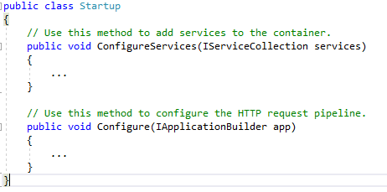
The Startup class
Startup Class is the entry point of the application. It configures the request pipeline which handles all requests made to the application.
The inception of startup class is in OWIN (Open Web Interface for .NET) application that is specification to reduce dependency of application on server.
Startup class example

Slide 10
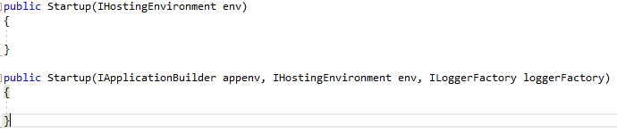
The Startup class Constructor
We can also specify constructor of the startup class. The startup class has constructor with one or three parameters.
IApplicationBuilder is an interface that contains properties and methods related to current environment. It is used to get the environment variables in application.
IHostingEnvironment is an interface that contains information related to the web hosting environment on which application is running. Using this interface method, we can change behavior of application.
IloggerFactory is an interface that provides configuration for the logging system in Asp.net Core. It also creates the instance of logging system.

Slide 11
The Startup class
The startup class contains two methods:
ConfigureServices and
Configure.

Slide 12

ConfigureServices Method
Declaration of this method is not mandatory in startup class. This method is used to configure services that are used by the application. When the application is requested for the first time, it calls ConfigureServices method. This method must be declared with a public access modifier, so that environment will be able to read the content from metadata.
ASP.NET Core has built-in support for Dependency Injection. We can add services to DI container using this method. Following are ways to define ConfigureServices method in startup class.
In case of specific class or library of project that would like to add to DI container, we will use the IserviceCollection.

Slide 13
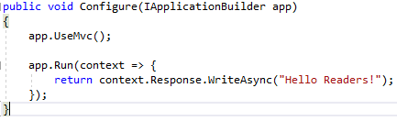
Configure Method
This method is used to define how the application will respond on each HTTP request i.e. we can control the ASP.NET pipeline. This method is also used to configure middleware in HTTP pipeline. This method accept IApplicationBuilder as a parameter. This method may accept some optional parameter such as IHostingEnvironment and ILoggerFactory. Whenever any service is added to ConfigureServices method, it is available to use in this method.
In the above example, We have added "UseMvc" method, so system will know MVC framework need to use to handle user requests. With this method, we can also pass some additional option parameters.

Slide 14
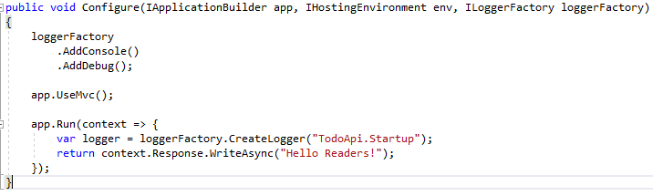
Configure Method
In the above example, We have added the logger console and the debug logger and MVC service. The app.Run method adds a terminal middleware delegate to the application's request pipeline.

Slide 15
Dependency Injection
Dependency injection (DI) is a technique for achieving loose coupling between objects and their collaborators, or dependencies. Rather than directly instantiating collaborators, or using static references, the objects a class needs in order to perform its actions are provided to the class in some fashion.
Classes will declare their dependencies via their constructor, allowing them to follow the Explicit Dependencies Principle. This approach is known as “constructor injection”.

Slide 16
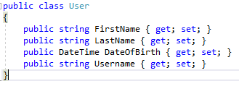
Dependency Injection Example
To demonstrate how Dependency Injection works in an ASP.NET Core app, let's set up a basic MVC app as a demo.
Pretend we need to model a list of users for our application. The class which represents these users might look like this:

Slide 17
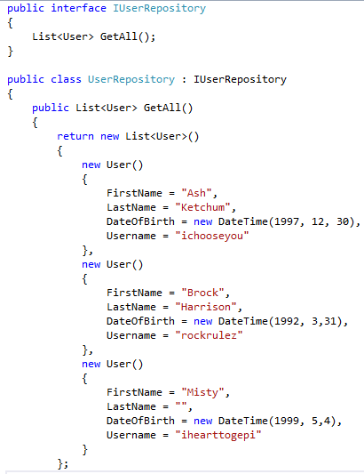
Dependency Injection Example
We will also need an interface and repository for retrieving the users. The interface and class will look like this:

Slide 18
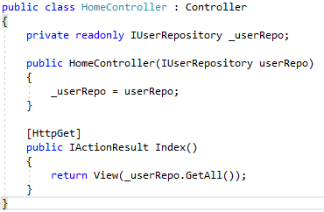
Dependency Injection Example
The reason we need an interface here is because our MVC controllers will reference the interface, not the class. Speaking of the controller, let's define one now:
Notice the setup here. We have a private readonly instance of our interface IUserRepository, and the constructor takes an instance of IUserRepository and sets our private instance to the passed-in instance. This is constructor injection at its simplest.

Slide 19
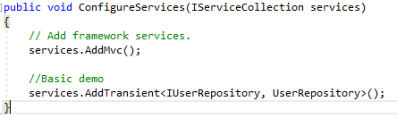
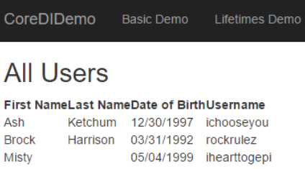
Dependency Injection Example
ASP.NET Core projects have a Startup.cs file, which configures the environment in which our app will run. The Startup.cs file also places services into ASP.NET Core's Services layer, which is what enables dependency injection.
Here's how we must modify our Startup.cs file to inject IUserRepository into our controller:
Here's what our page looks like when we get there:

Slide 20
Dependency Injection Lifetimes
In ASP.NET Core's DI implementation, we see the concept of "lifetimes". A lifetime specifies when a DI-injected object gets created or recreated. There are three possibilities:
Transient: Created each time they are requested.
Scoped: Created once per request.
Singleton: Created the first time they are requested. Each subsequent request uses the instance that was created the first time.

Slide 21
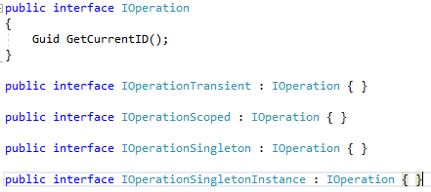
Dependency Injection Lifetime
To demonstrate how these lifetimes work, let's define a few interfaces. We'll need an interface IOperation which represents an operation being done in each of these lifetimes. Said operation will do one thing: it will return either Guid.NewGuid() or the passed-in Guid value from its one method. We'll also define four additional interfaces, each of which represents that operation during a specific lifetime:
IOperationSingletonInstance is a special form of this operation which will always return a blank Guid.

Slide 22
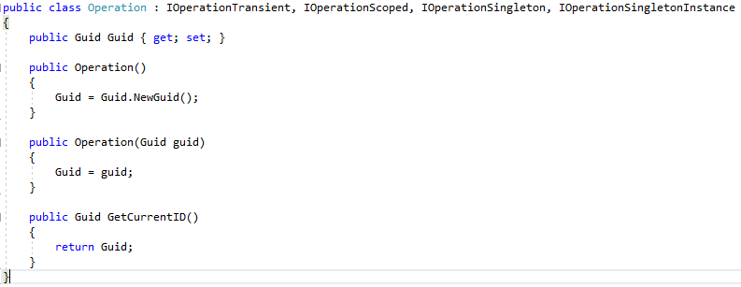
Dependency Injection Lifetime
Now we can define the Operation class itself, which implements the four lifetime interfaces and defines the GetCurrentID() method.
Our Operation class will either return Guid.NewGuid() or used the Guid passed in to the constructor (this scenario is for the IOperationSingletonInstance interface demo).

Slide 23
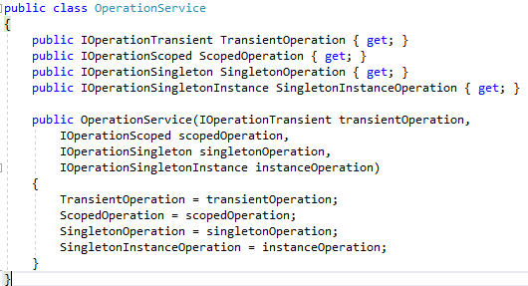
Dependency Injection Lifetime
To fully show how Transient operations work, we also need to define another class which represents a separate set of instances of these interfaces (separate from the ones being injected into our controller). We'll call this class OperationServices and it looks like this:

Slide 24
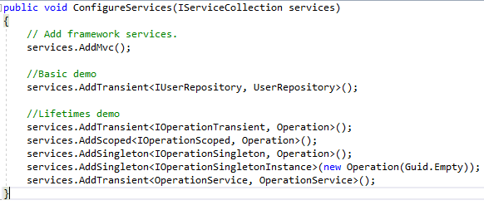
Dependency Injection Lifetime
Now we need to register the four lifetime interfaces and our OperationServices class into our Dependency Injection container. We do so in the Startup class's ConfigureServices() method, just like we registered the IUserRepository class earlier.

Slide 25
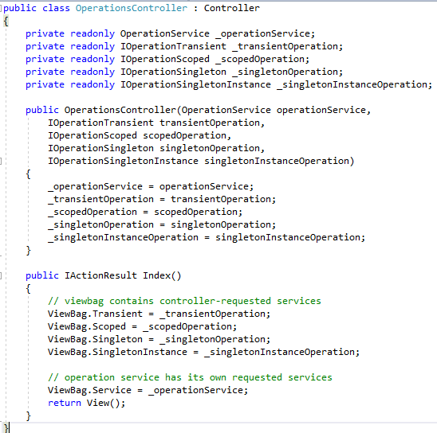
Dependency Injection Lifetime
With all our dependencies registered, we can now create an OperationsController which will demo how these lifetimes work.

Slide 26
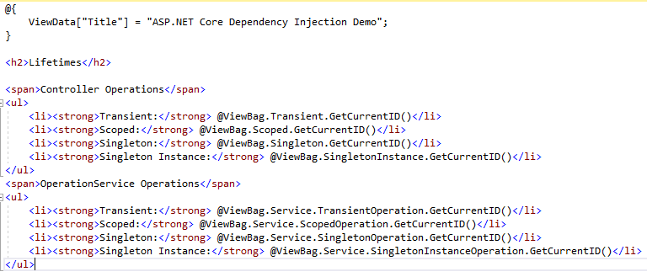
Dependency Injection Lifetime
For posterity, We will also include the .cshtml file which displays the results of that Index() action:

Slide 27
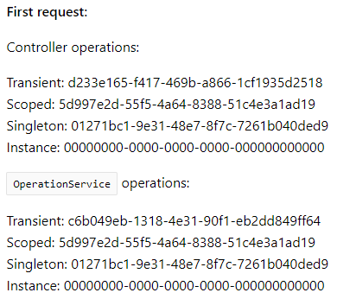
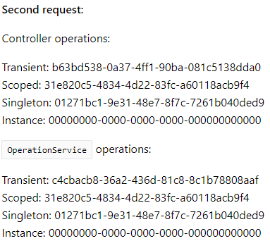
Testing the Lifetime
With all of our code in place, we are now ready to test. Let's look at two screenshots of that demo page. The first screenshot is when we first load the page.
The second screenshot is of the same page after doing a refresh:

Slide 28
Testing Lifetime
We need to notice a few things about the differences in these screenshots:
Each time it shows up, the Transient Guid is different.
The Scoped Guids are the same for both calls in a single screenshot, but not in each screenshot (request).
Singleton objects are the same for every object and every request regardless of whether an Operation instance is provided in ConfigureServices.
The Singleton Instance Guids (as expected) are always 0s.

Slide 29
Middleware
Middleware is software that's assembled into an app pipeline to handle requests and responses. Each component:
Chooses whether to pass the request to the next component in the pipeline.
Can perform work before and after the next component in the pipeline.

Slide 30
Middleware
There will be multiple middleware in ASP.NET Core web application. It can be either framework provided middleware, added via NuGet or own custom middleware. We can set the order of middleware execution in the request pipeline. Each middleware adds or modifies http request and optionally passes control to the next middleware component. The following figure illustrates the execution of middleware components.
Middleware1
//logic
Next();
//more logic
Middleware2
//logic
Next();
//more logic
Middleware3
//logic
//morelogic
Request
Response

Slide 31
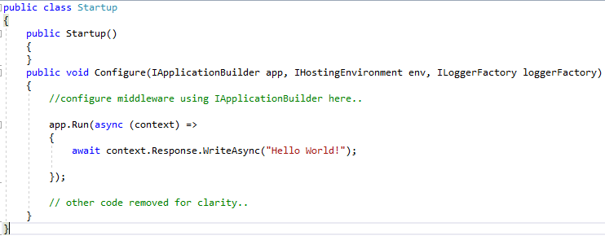
Example
The following example adds a single middleware using Run method which returns a string "Hello World!" on each request.
In the above example, Run() is an extension method on IApplicationBuilder instance which adds a terminal middleware to the application's request pipeline. The above configured middleware returns a response with a string "Hello World!" for each request.

Slide 32
Understand Run Method
We used Run extension method to add middleware. The following is the signature of the Run method:
The Run method is an extension method on IApplicationBuilder and accepts a parameter of RequestDelegate. The RequestDelegate is a delegate method which handles the request. The following is a RequestDelegate signature.
The Run method accepts a method as a parameter whose signature should match with RequestDelegate. Therefore, the method should accept the HttpContext parameter and return Task. So, you can either specify a lambda expression or specify a function in the Run method.

Slide 33
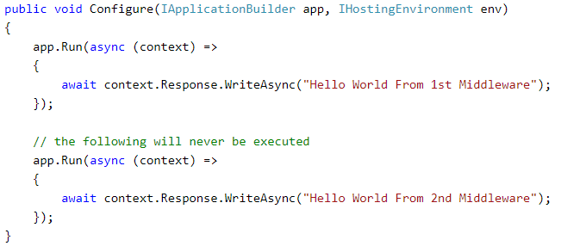
Configure Multiple Middleware
Mostly there will be multiple middleware components in ASP.NET Core application which will be executed sequentially. The Run method adds a terminal middleware so it cannot call next middleware as it would be the last middleware in a sequence. The following will always execute the first Run method and will never reach the second Run method.

Slide 34
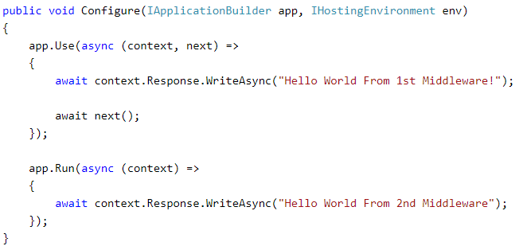
Configure Multiple Middleware
To configure multiple middleware, use Use() extension method. It is similar to Run() method except that it includes next parameter to invoke next middleware in the sequence. Consider the following example.
The above example will display Hello World From 1st Middleware!Hello World From 2nd Middleware! in the browser.

Slide 35
Add Built-in Middleware Via NuGet
The followings are some built-in middleware:
Middleware | Description
Authentication | Adds authentication support.
CORS | Configures Cross-Origin Resource Sharing.
Routing | Adds routing capabilities for MVC or web form
Session | Adds support for user session.
StaticFiles | Adds support for serving static files and directory browsing.
Diagnostics | Adds support for reporting and handling exceptions and errors.

Slide 36
Diagnostics Middleware
Diagnostics middleware is used for reporting and handling exceptions and errors in ASP.NET Core, and diagnosing Entity Framework Core migrations errors.
Open project.json and add Microsoft.AspNetCore.Diagnostics dependency if it is not added. Wait for some time till Visual Studio restores the packages.

Slide 37
Diagnostics Middleware
This package includes following middleware and extension methods for it.
Middleware | Extension Method | Description
DeveloperExceptionPageMiddleware | UseDeveloperExceptionPage() | Captures synchronous and asynchronous exceptions from the pipeline and generates HTML error responses.
ExceptionHandlerMiddleware | UseExceptionHandler() | Catch exceptions, log them and re-execute in an alternate pipeline.
StatusCodePagesMiddleware | UseStatusCodePages() | Check for responses with status codes between 400 and 599.
WelcomePageMiddleware | UseWelcomePage() | Display Welcome page for the root path.

Slide 38
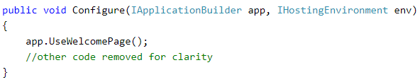
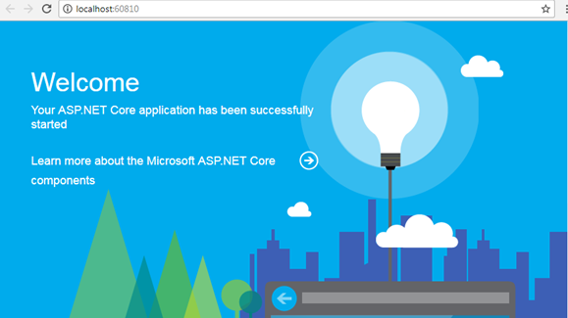
Example: Add Diagnostics Middleware
Let's add welcomePage middleware which will display welcome page for the root path.
Output:

Slide 39
ASP.NET Core Web Host
ASP.NET Core apps configure and launch a host.
The host is responsible for app startup and lifetime management. At a minimum, the host configures a server and a request processing pipeline.
The host can also set up logging, dependency injection, and configuration.

Slide 40
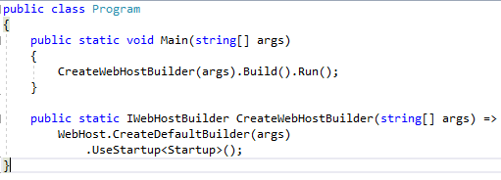
Set up a host
The WebHostBuilder class is available from the following namespace (specific to ASP .NET Core), implementing the IWebHostBuilder interface:
Create a host using an instance of IWebHostBuilder. This is typically performed in the app's entry point, the Main method. In the project templates, Main is located in Program.cs. A typical Program.cs calls CreateDefaultBuilder to start setting up a host:

Slide 41
Set up a host
CreateDefaultBuilder performs the following tasks:
Configures Kestrel server as the web server using the app's hosting configuration providers. For the Kestrel server's default options, see Kestrel web server implementation in ASP.NET Core.
Sets the content root to the path returned by Directory.GetCurrentDirectory.
Loads host configuration from:
Environment variables prefixed with ASPNETCORE_ (for example, ASPNETCORE_ENVIRONMENT).
Command-line arguments.
Loads app configuration in the following order from:
appsettings.json.
appsettings.{Environment}.json.
Secret Manager when the app runs in the Development environment using the entry assembly.
Environment variables.
Command-line arguments.

Slide 42
Set up a host
Configures logging for console and debug output. Logging includes log filtering rules specified in a Logging configuration section of an appsettings.json or appsettings.{Environment}.json file.
When running behind IIS with the ASP.NET Core Module, CreateDefaultBuilder enables IIS Integration, which configures the app's base address and port. IIS Integration also configures the app to capture startup errors. For the IIS default options, see Host ASP.NET Core on Windows with IIS.
Sets ServiceProviderOptions.ValidateScopes to true if the app's environment is Development. For more information, see Scope validation.

Slide 43
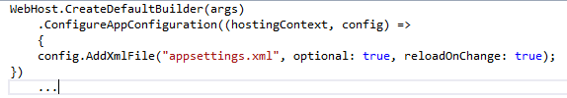
Set up a host
The configuration defined by CreateDefaultBuilder can be overridden and augmented by ConfigureAppConfiguration, ConfigureLogging, and other methods and extension methods of IWebHostBuilder. A few examples follow:
ConfigureAppConfiguration is used to specify additional IConfiguration for the app. The following ConfigureAppConfiguration call adds a delegate to include app configuration in the appsettings.xml file. ConfigureAppConfiguration may be called multiple times.
Notes:
Note: That this configuration doesn't apply to the host (for example, server URLs or environment).

Slide 44
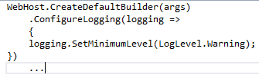

Set up a host
The following ConfigureLogging call adds a delegate to configure the minimum logging level (SetMinimumLevel) to LogLevel.Warning. This setting overrides the settings in appsettings.Development.json (LogLevel.Debug) and appsettings.Production.json (LogLevel.Error) configured by CreateDefaultBuilder. ConfigureLogging may be called multiple times.
The following call to ConfigureKestrel overrides the default Limits.MaxRequestBodySize of 30,000,000 bytes established when Kestrel was configured by CreateDefaultBuilder:

Slide 45
Host configuration values
WebHostBuilder relies on the following approaches to set the host configuration values:
Host builder configuration, which includes environment variables with the format ASPNETCORE_{configurationKey}. For example, ASPNETCORE_ENVIRONMENT.
Extensions such as UseContentRoot and UseConfiguration (see the Override configuration section).
UseSetting and the associated key. When setting a value with UseSetting, the value is set as a string regardless of the type.

Slide 46
Application Key (Name)
The IHostingEnvironment.ApplicationName property is automatically set when UseStartup or Configure is called during host construction. The value is set to the name of the assembly containing the app's entry point. To set the value explicitly, use the WebHostDefaults.ApplicationKey:
Key: applicationName
Type: string
Default: The name of the assembly containing the app's entry point.
Set using: UseSetting
Environment variable: ASPNETCORE_APPLICATIONNAME

Slide 47

Capture Startup Errors
This setting controls the capture of startup errors.
Key: captureStartupErrors
Type: bool (true or 1)
Default: Defaults to false unless the app runs with Kestrel behind IIS, where the default is true.
Set using: CaptureStartupErrors
Environment variable: ASPNETCORE_CAPTURESTARTUPERRORS
When false, errors during startup result in the host exiting. When true, the host captures exceptions during startup and attempts to start the server.

Slide 48

Content Root
This setting determines where ASP.NET Core begins searching for content files, such as MVC views.
Key: contentRoot
Type: string
Default: Defaults to the folder where the app assembly resides.
Set using: UseContentRoot
Environment variable: ASPNETCORE_CONTENTROOT
The content root is also used as the base path for the Web Root setting. If the path doesn't exist, the host fails to start.

Slide 49

Detailed Errors
Determines if detailed errors should be captured.
Key: detailedErrors
Type: bool (true or 1)
Default: false
Set using: UseSetting
Environment variable: ASPNETCORE_DETAILEDERRORS
When enabled (or when the Environment is set to Development), the app captures detailed exceptions.

Slide 50

Environment
Sets the app's environment.
Key: environment
Type: string
Default: Production
Set using: UseEnvironment
Environment variable: ASPNETCORE_ENVIRONMENT
The environment can be set to any value. Framework-defined values include Development, Staging, and Production. Values aren't case sensitive. By default, the Environment is read from the ASPNETCORE_ENVIRONMENT environment variable. When using Visual Studio, environment variables may be set in the launchSettings.json file.

Slide 51
Hosting Startup Assemblies
Sets the app's hosting startup assemblies.
Key: hostingStartupAssemblies
Type: string
Default: Empty string
Set using: UseSetting
Environment variable: ASPNETCORE_HOSTINGSTARTUPASSEMBLIES
A semicolon-delimited string of hosting startup assemblies to load on startup.
Although the configuration value defaults to an empty string, the hosting startup assemblies always include the app's assembly. When hosting startup assemblies are provided, they're added to the app's assembly for loading when the app builds its common services during startup.

Slide 52

HTTP Ports
Set the HTTPS redirect port. Used in enforcing HTTPS.
Key: https_port
Type: string
Default: A default value isn't set.
Set using: UseSetting
Environment variable: ASPNETCORE_HTTPS_PORT

Slide 53
Hosting Startup Exclude Assemblies
A semicolon-delimited string of hosting startup assemblies to exclude on startup.
Key: hostingStartupExcludeAssemblies
Type: string
Default: Empty string
Set using: UseSetting
Environment variable: ASPNETCORE_HOSTINGSTARTUPEXCLUDEASSEMBLIES

Slide 54

Prefer hosting URLs
Indicates whether the host should listen on the URLs configured with the WebHostBuilder instead of those configured with the IServer implementation.
Key: preferHostingUrls
Type: bool (true or 1)
Default: true
Set using: PreferHostingUrls
Environment variable: ASPNETCORE_PREFERHOSTINGURLS

Slide 55
Prevent Hosting Startup
Prevents the automatic loading of hosting startup assemblies, including hosting startup assemblies configured by the app's assembly.
Key: preventHostingStartup
Type: bool (true or 1)
Default: false
Set using: UseSetting
Environment variable: ASPNETCORE_PREVENTHOSTINGSTARTUP

Slide 56
Server URLs
Indicates the IP addresses or host addresses with ports and protocols that the server should listen on for requests.
Key: urls
Type: string
Default: http://localhost:5000
Set using: UseUrls
Environment variable: ASPNETCORE_URLS
Set to a semicolon-separated (;) list of URL prefixes to which the server should respond. For example, http://localhost:123. Use "*" to indicate that the server should listen for requests on any IP address or hostname using the specified port and protocol (for example, http://*:5000). The protocol (http:// or https://) must be included with each URL. Supported formats vary among servers.

Slide 57

Shutdown Timeout
Specifies the amount of time to wait for Web Host to shut down.
Key: shutdownTimeoutSeconds
Type: int
Default: 5
Set using: UseShutdownTimeout
Environment variable: ASPNETCORE_SHUTDOWNTIMEOUTSECONDS
Although the key accepts an int with UseSetting (for example, .UseSetting(WebHostDefaults.ShutdownTimeoutKey, "10")), the UseShutdownTimeout extension method takes a TimeSpan.
During the timeout period, hosting:
Triggers IApplicationLifetime.ApplicationStopping.
Attempts to stop hosted services, logging any errors for services that fail to stop.
If the timeout period expires before all of the hosted services stop, any remaining active services are stopped when the app shuts down. The services stop even if they haven't finished processing. If services require additional time to stop, increase the timeout.

Slide 58


Startup Assembly
Determines the assembly to search for the Startup class.
Key: startupAssembly
Type: string
Default: The app's assembly
Set using: UseStartup
Environment variable: ASPNETCORE_STARTUPASSEMBLY
The assembly by name (string) or type (TStartup) can be referenced. If multiple UseStartup methods are called, the last one takes precedence.

Slide 59

Web Root
Sets the relative path to the app's static assets.
Key: webroot
Type: string
Default: If not specified, the default is "(Content Root)/wwwroot", if the path exists. If the path doesn't exist, then a no-op file provider is used.
Set using: UseWebRoot
Environment variable: ASPNETCORE_WEBROOT

Slide 60
Override Configuration
Use Configuration to configure Web Host.
In the following example, host configuration is optionally specified in a hostsettings.json file. Any configuration loaded from the hostsettings.json file may be overridden by command-line arguments. The built configuration (in config) is used to configure the host with UseConfiguration. IWebHostBuilder configuration is added to the app's configuration, but the converse isn't true—ConfigureAppConfiguration doesn't affect the IWebHostBuilder configuration.

Slide 61
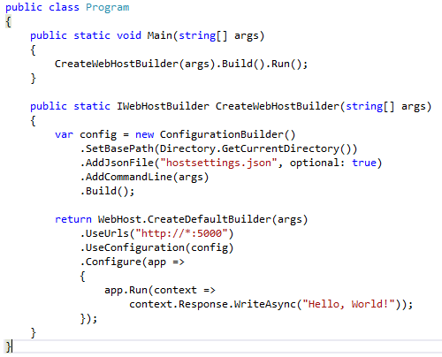
Override Configuration
Overriding the configuration provided by UseUrls with hostsettings.json config first, command-line argument config second:

Slide 62


Override Configuration
hostsetting.json
JSON:
To specify the host run on a particular URL, the desired value can be passed in from a command prompt when executing dotnet run. The command-line argument overrides the urls value from the hostsettings.json file, and the server listens on port 8080:

Slide 63

Manage the host
Run
The Run method starts the web app and blocks the calling thread until the host is shut down:

Slide 64

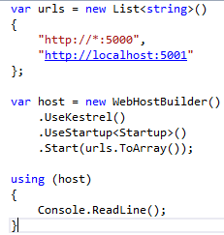
Start
Run the host in a non-blocking manner by calling its Start method:
If a list of URLs is passed to the Start method, it listens on the URLs specified:

Slide 65
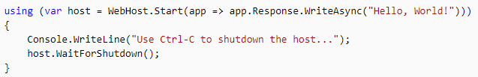
Start(RequestDelegate app)
Start with RequestDelegate:
Make a request in the browser to http://localhost:5000 to receive the response "Hello World!" WaitForShutdown blocks until a break (Ctrl-C/SIGINT or SIGTERM) is issued. The app displays the Console.WriteLine message and waits for a keypress to exit.

Slide 66

Start(string url, RequestDelegate app)
Start with a URL and RequestDelegate:
Produces the same result as Start(RequestDelegate app), except the app responds on http://localhost:8080.

Slide 67
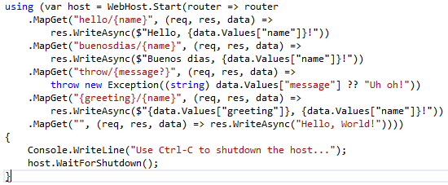
Start(Action<IRouteBuilder> routeBuilder)
Use an instance of IRouteBuilder (Microsoft.AspNetCore.Routing) to use routing middleware:

Slide 68
Start(Action<IRouteBuilder> routeBuilder)
Use the following browser requests with the example:
WaitForShutdown blocks until a break (Ctrl-C/SIGINT or SIGTERM) is issued. The app displays the Console.WriteLine message and waits for a keypress to exit.
Request | Response
http://localhost:5000/hello/Martin | Hello, Martin!
http://localhost:5000/buenosdias/Catrina | Buenos dias, Catrina!
http://localhost:5000/throw/ooops! | Throws an exception with string "ooops!"
http://localhost:5000/throw | Throws an exception with string "Uh oh!"
http://localhost:5000/Sante/Kevin | Sante, Kevin!
http://localhost:5000 | Hello World!

Slide 69
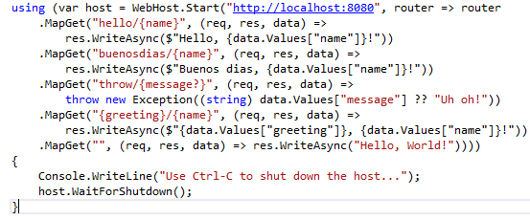
String(string url, Action<IRouteBuilder> routeBuilder)
Use a URL and an instance of IRouteBuilder:
Produces the same result as Start(Action<IRouteBuilder> routeBuilder), except the app responds at http://localhost:8080.

Slide 70
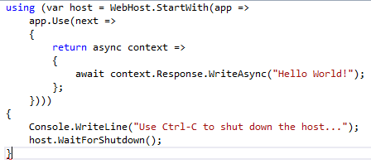
StartWith(Action<IApplicationBuilder> app)
Provide a delegate to configure an IApplicationBuilder:
Make a request in the browser to http://localhost:5000 to receive the response "Hello World!" WaitForShutdown blocks until a break (Ctrl-C/SIGINT or SIGTERM) is issued. The app displays the Console.WriteLine message and waits for a keypress to exit.

Slide 71
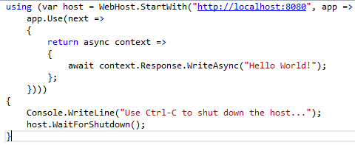
StartWith(string url, Action<Iapplication Builder> app)
Provide a URL and a delegate to configure an IApplicationBuilder:
Produces the same result as StartWith(Action<IApplicationBuilder> app), except the app responds on http://localhost:8080.

Slide 72
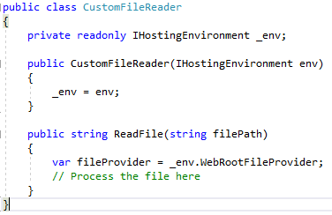
IHostingEnvironment interface
The IHostingEnvironment interface provides information about the app's web hosting environment. Use constructor injection to obtain the IHostingEnvironment in order to use its properties and extension methods:

Slide 73
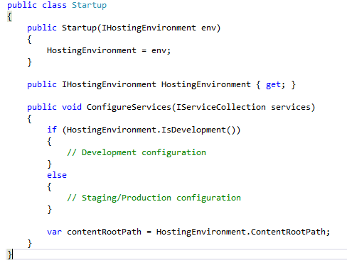
IHostingEnvironment interface
A convention-based approach can be used to configure the app at startup based on the environment. Alternatively, inject the IHostingEnvironment into the Startup constructor for use in ConfigureServices:

Slide 74
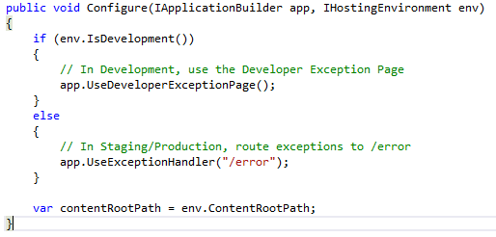
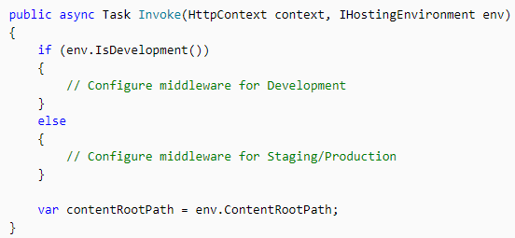
IHostingEnvironment interface
The IHostingEnvironment service can also be injected directly into the Configure method for setting up the processing pipeline:
IHostingEnvironment can be injected into the Invoke method when creating custom middleware:

Slide 75
IApplicationLifetime interface
IApplicationLifetime allows for post-startup and shutdown activities. Three properties on the interface are cancellation tokens used to register Action methods that define startup and shutdown events.
Cancellation Token | Triggered when…
ApplicationStarted | The host has fully started.
ApplicationStopped | The host is completing a graceful shutdown. All requests should be processed. Shutdown blocks until this event completes.
ApplicationStopping | The host is performing a graceful shutdown. Requests may still be processing. Shutdown blocks until this event completes.

Slide 76
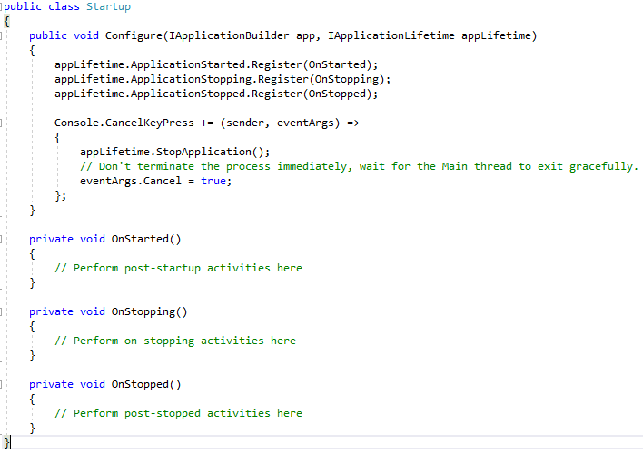
IApplicationLifetime interface

Slide 77
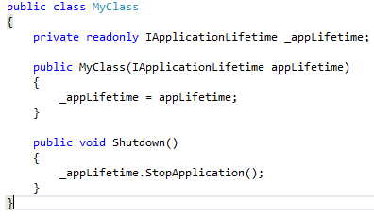
IApplicationLifetime interface
StopApplication requests termination of the app. The following class uses StopApplication to gracefully shut down an app when the class's Shutdown method is called:

Slide 78
Generic Host
The purpose of Generic Host is to decouple the HTTP pipeline from the Web Host API to enable a wider array of host scenarios. Messaging, background tasks, and other non-HTTP workloads based on Generic Host benefit from cross-cutting capabilities, such as configuration, dependency injection (DI), and logging.
Generic Host is new in ASP.NET Core 2.1 and isn't suitable for web hosting scenarios. For web hosting scenarios, use the Web Host. Generic Host will replace Web Host in a future release and act as the primary host API in both HTTP and non-HTTP scenarios.

Slide 79
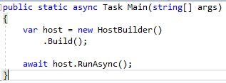
Setup a host
The HostBuilder class is available from the following namespace, implementing the IHostBuilder interface:
At a minimum, the Main() method of your .NET Core app would look like the following:
Here, the Build() method initializes the host, so it can only be called once for initialization.

Slide 80
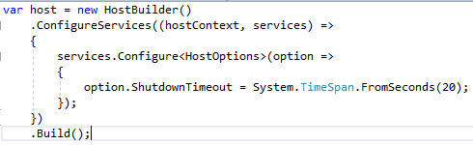
Shutdown timeout
ShutdownTimeout sets the timeout for StopAsync. The default value is five seconds.
The following option configuration in Program.Main increases the default five second shutdown timeout to 20 seconds:

Slide 81
Default Service
The following services are registered during host initialization:
Environment (IHostingEnvironment)
HostBuilderContext
Configuration (IConfiguration)
IApplicationLifetime (ApplicationLifetime)
IHostLifetime (ConsoleLifetime)
IHost
Options (AddOptions)
Logging (AddLogging)

Slide 82
Host Configuration
Host configuration is created by:
Calling extension methods on IHostBuilder to set the content root and environment.
Reading configuration from configuration providers in ConfigureHostConfiguration.

Slide 83
Application key (name)
The IHostingEnvironment.ApplicationName property is set from host configuration during host construction. To set the value explicitly, use the HostDefaults.ApplicationKey:
Key: applicationName
Type: string
Default: The name of the assembly containing the app's entry point.
Set using: HostBuilderContext.HostingEnvironment.ApplicationName
Environment variable: <PREFIX_>APPLICATIONNAME (<PREFIX_> is optional and user-defined)

Slide 84

Content root
This setting determines where the host begins searching for content files.
Key: contentRoot
Type: string
Default: Defaults to the folder where the app assembly resides.
Set using: UseContentRoot
Environment variable: <PREFIX_>CONTENTROOT (<PREFIX_> is optional and user-defined)
If the path doesn't exist, the host fails to start.

Slide 85

Environment
Sets the app's environment.
Key: environment
Type: string
Default: Production
Set using: UseEnvironment
Environment variable: <PREFIX_>ENVIRONMENT (<PREFIX_> is optional and user-defined)
The environment can be set to any value. Framework-defined values include Development, Staging, and Production. Values aren't case sensitive.

Slide 86
ConfigureHostConfiguration
ConfigureHostConfiguration uses an IConfigurationBuilder to create an IConfiguration for the host. The host configuration is used to initialize the IHostingEnvironment for use in the app's build process.
ConfigureHostConfiguration can be called multiple times with additive results. The host uses whichever option sets a value last on a given key.
Host configuration automatically flows to app configuration (ConfigureAppConfiguration and the rest of the app).
No providers are included by default. You must explicitly specify whatever configuration providers the app requires in ConfigureHostConfiguration, including:
File configuration (for example, from a hostsettings.json file).
Environment variable configuration.
Command-line argument configuration.
Any other required configuration providers.

Slide 87

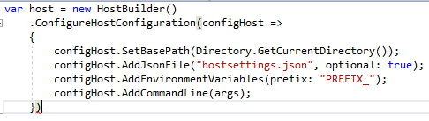
ConfigureHostConfiguration
hostsettings.json
Additional configuration can be provided with the applicationName and contentRoot keys.
Example HostBuilder configuration using ConfigureHostConfiguration:

Slide 88
ConfigureAppConfiguration
App configuration is created by calling ConfigureAppConfiguration on the IHostBuilder implementation. ConfigureAppConfiguration uses an IConfigurationBuilder to create an IConfiguration for the app. ConfigureAppConfiguration can be called multiple times with additive results. The app uses whichever option sets a value last on a given key. The configuration created by ConfigureAppConfiguration is available at HostBuilderContext.Configuration for subsequent operations and in Services.
App configuration automatically receives host configuration provided by ConfigureHostConfiguration.

Slide 89
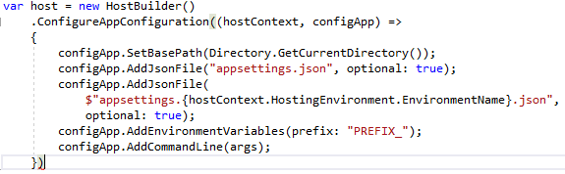
Example
Example app configuration using ConfigureAppConfiguration

Slide 90
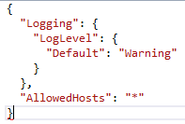
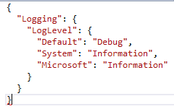
Example
Appsettings.json
Appsetting.Development.json

Slide 91
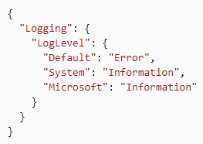
Example
Appsettings.Production.json
To move settings files to the output directory, specify the settings files as MSBuild project items in the project file. The sample app moves its JSON app settings files and hostsettings.json with the following <Content> item:

Slide 92
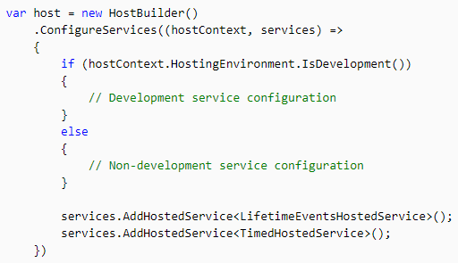
ConfigureService
ConfigureServices adds services to the app's dependency injection container. ConfigureServices can be called multiple times with additive results.
A hosted service is a class with background task logic that implements the IHostedService interface. For more information, see Background tasks with hosted services in ASP.NET Core.
The sample app uses the AddHostedService extension method to add a service for lifetime events, LifetimeEventsHostedService, and a timed background task, TimedHostedService, to the app:

Slide 93
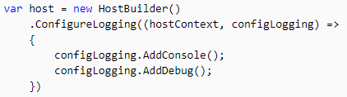
ConfigureLogging
ConfigureLogging adds a delegate for configuring the provided ILoggingBuilder. ConfigureLogging may be called multiple times with additive results.

Slide 94

UseConsoleLifetime
UseConsoleLifetime listens for Ctrl+C/SIGINT or SIGTERM and calls StopApplication to start the shutdown process. UseConsoleLifetime unblocks extensions such as RunAsync and WaitForShutdownAsync. ConsoleLifetime is pre-registered as the default lifetime implementation. The last lifetime registered is used.

Slide 95
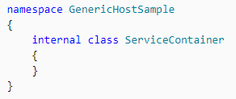
Container Configuration
Custom container configuration is managed by the ConfigureContainer method. ConfigureContainer provides a strongly-typed experience for configuring the container on top of the underlying host API. ConfigureContainer can be called multiple times with additive results.
Create a service container for the app:

Slide 96
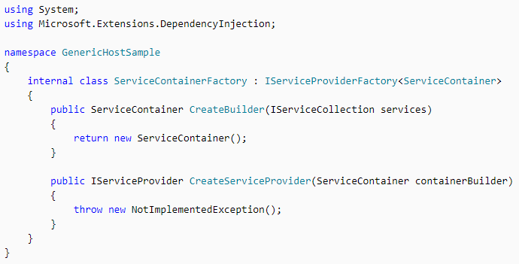
Container Configuration
Provide service container factory

Slide 97
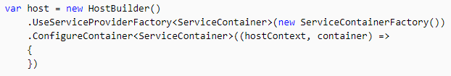
Container Configuration
Use the factory and configure the custom service container for the app:

Slide 98

Extensibility
Host extensibility is performed with extension methods on IHostBuilder. The following example shows how an extension method extends an IHostBuilder implementation with the TimedHostedService example demonstrated in Background tasks with hosted services in ASP.NET Core.

Slide 99

Extensibility
An app establishes the UseHostedService extension method to register the hosted service passed in T:

Slide 100

Manage the host
The IHost implementation is responsible for starting and stopping the IHostedService implementations that are registered in the service container.
Run
Run runs the app and blocks the calling thread until the host is shut down:

Slide 101

RunAsync
RunAsync runs the app and returns a Task that completes when the cancellation token or shutdown is triggered:

Slide 102

RunControlAsync
RunConsoleAsync enables console support, builds and starts the host, and waits for Ctrl+C/SIGINT or SIGTERM to shut down.

Slide 103

Start and StopAsync
Start starts the host synchronously.
StopAsync attempts to stop the host within the provided timeout.

Slide 104

StartAsync and StopAsync
StartAsync starts the app.
StopAsync stops the app.

Slide 105

WaitForShutdown
WaitForShutdown is triggered via the IHostLifetime, such as ConsoleLifetime (listens for Ctrl+C/SIGINT or SIGTERM). WaitForShutdown calls StopAsync.

Slide 106

WaitForShutdownAsync
WaitForShutdownAsync returns a Task that completes when shutdown is triggered via the given token and calls StopAsync.

Slide 107

External Control
External control of the host can be achieved using methods that can be called externally:
WaitForStartAsync is called at the start of StartAsync, which waits until it's complete before continuing. This can be used to delay startup until signaled by an external event.

Slide 108

IHostingEnvironment interface
IHostingEnvironment provides information about the app's hosting environment. Use constructor injection to obtain the IHostingEnvironment in order to use its properties and extension methods:

Slide 109
IApplicationLifetime interface
IApplicationLifetime allows for post-startup and shutdown activities, including graceful shutdown requests. Three properties on the interface are cancellation tokens used to register Action methods that define startup and shutdown events.
Cancellation Token | Triggered when…
ApplicationStarted | The host has fully started.
ApplicationStopped | The host is completing a graceful shutdown. All requests should be processed. Shutdown blocks until this event completes.
ApplicationStopping | The host is performing a graceful shutdown. Requests may still be processing. Shutdown blocks until this event completes.

Slide 110

IApplicationLifetime interface
Constructor-inject the IApplicationLifetime service into any class. The sample app uses constructor injection into a LifetimeEventsHostedService class (an IHostedService implementation) to register the events.
LifetimeEventsHostedService.cs:

Slide 111


IApplicationLifetime interface
StopApplication requests termination of the app. The following class uses StopApplication to gracefully shut down an app when the class's Shutdown method is called:

Slide 112
Web Server implementations in ASP.NET Core
An ASP.NET Core app runs with an in-process HTTP server implementation. The server implementation listens for HTTP requests and surfaces them to the app as a set of request features composed into an HttpContext.
For Windows
ASP.NET Core ships with the following:
Kestrel server is the default, cross-platform HTTP server implementation.
IIS HTTP Server is an in-process server for IIS.
HTTP.sys server is a Windows-only HTTP server based on the HTTP.sys kernel driver and HTTP Server API.

Slide 113
Web Server implementations in ASP.NET Core
When using IIS or IIS Express, the app either runs:
In the same process as the IIS worker process (the in-process hosting model) with the IIS HTTP Server. In-process is the recommended configuration.
In a process separate from the IIS worker process (the out-of-process hosting model) with the Kestrel server.
The ASP.NET Core Module is a native IIS module that handles native IIS requests between IIS and the in-process IIS HTTP Server or Kestrel. For more information, see ASP.NET Core Module.

Slide 114
Hosting Models
In-process hosting model
Using in-process hosting, an ASP.NET Core app runs in the same process as its IIS worker process.
In-process hosting provides improved performance over out-of-process hosting because requests aren't proxied over the loopback adapter, a network interface that returns outgoing network traffic back to the same machine.
IIS handles process management with the Windows Process Activation Service (WAS).

Slide 115
Hosting Model
The ASP.NET Core Module:
Performs app initialization.
Loads the CoreCLR.
Calls Program.Main.
Handles the lifetime of the IIS native request.
The in-process hosting model isn't supported for ASP.NET Core apps that target the .NET Framework.

Slide 116
Hosting Model
The following diagram illustrates the relationship between IIS, the ASP.NET Core Module, and an app hosted in-process:
IIS
ASP.NET Core Application
(w3wp.exe)
ASP.NET Core Module
IISHTTP Server
HttpContext
Application Code
HTTP
Internet
http://contoso.com

Slide 117
Hosting Model
A request arrives from the web to the kernel-mode HTTP.sys driver. The driver routes the native request to IIS on the website's configured port, usually 80 (HTTP) or 443 (HTTPS). The module receives the native request and passes it to IIS HTTP Server (IISHttpServer). IIS HTTP Server is an in-process server implementation for IIS that converts the request from native to managed.
After the IIS HTTP Server processes the request, the request is pushed into the ASP.NET Core middleware pipeline. The middleware pipeline handles the request and passes it on as an HttpContext instance to the app's logic. The app's response is passed back to IIS through IIS HTTP Server. IIS sends the response to the client that initiated the request.
In-process hosting is opt-in for existing apps, but dotnet new templates default to the in-process hosting model for all IIS and IIS Express scenarios.

Slide 118
Hosting Model
Out-of-process hosting model
The module starts the process for the ASP.NET Core app when the first request arrives and restarts the app if it shuts down or crashes. This is essentially the same behavior as seen with apps that run in-process that are managed by the Windows Process Activation Service (WAS).
The following diagram illustrates the relationship between IIS, the ASP.NET Core Module, and an app hosted out-of-process:
IIS
(w3wp.exe)
ASP.NET Core Application
(dotnet.exe)
HTTP
ASP.NET Core Module
HTTP
Kestrel
Application Code
Internet
HTTPContext
http://contoso.com
http://localhost:1234

Slide 119
Hosting Model
Requests arrive from the web to the kernel-mode HTTP.sys driver. The driver routes the requests to IIS on the website's configured port, usually 80 (HTTP) or 443 (HTTPS). The module forwards the requests to Kestrel on a random port for the app, which isn't port 80 or 443.
The module specifies the port via an environment variable at startup, and the IIS Integration Middleware configures the server to listen on http://localhost:{PORT}. Additional checks are performed, and requests that don't originate from the module are rejected. The module doesn't support HTTPS forwarding, so requests are forwarded over HTTP even if received by IIS over HTTPS.
After Kestrel picks up the request from the module, the request is pushed into the ASP.NET Core middleware pipeline. The middleware pipeline handles the request and passes it on as an HttpContext instance to the app's logic. Middleware added by IIS Integration updates the scheme, remote IP, and pathbase to account for forwarding the request to Kestrel. The app's response is passed back to IIS, which pushes it back out to the HTTP client that initiated the request.

Slide 120
Kestrel
Kestrel is the default web server included in ASP.NET Core project templates.
Kestrel can be used:
By itself as an edge server processing requests directly from a network, including the Internet.
With a reverse proxy server, such as Internet Information Services (IIS), Nginx, or Apache. A reverse proxy server receives HTTP requests from the Internet and forwards them to Kestrel.
ASP.NET Core Application
HTTP
Kestrel
Application Code
Internet
HTTPContext
ASP.NET Core Application
I
Reverse proxy server
IIS, Ngix, Apache
HTTP
HTTP
Kestrel
Application Code
Internet
HTTPContext
Notes:
Either hosting configuration—with or without a reverse proxy server—is supported for ASP.NET Core 2.1 or later apps.

Slide 121
IIS HTTP Server
IIS HTTP Server is an in-process server for IIS and required for in-process deployments. The ASP.NET Core Module handles native IIS requests between IIS and IIS HTTP Server.

Slide 122
HTTP.sys
If ASP.NET Core apps are run on Windows, HTTP.sys is an alternative to Kestrel. Kestrel is generally recommended for best performance. HTTP.sys can be used in scenarios where the app is exposed to the Internet and required capabilities are supported by HTTP.sys but not Kestrel.
HTTP.sys can also be used for apps that are only exposed to an internal network.
ASP.NET Core Application
HTTP
HTTPSys
Application Code
Internet
HTTPContext
ASP.NET Core Application
HTTP
HTTPSys
Application Code
Internal
Network
HTTPContext

Slide 123
ASP.NET Core server Infrastructure
The IApplicationBuilder available in the Startup.Configure method exposes the ServerFeatures property of type IFeatureCollection. Kestrel and HTTP.sys only expose a single feature each, IServerAddressesFeature, but different server implementations may expose additional functionality.
IServerAddressesFeature can be used to find out which port the server implementation has bound at runtime.

Slide 124
Custom Servers
If the built-in servers don't meet the app's requirements, a custom server implementation can be created. The Open Web Interface for .NET (OWIN) guide demonstrates how to write a Nowin-based IServer implementation. Only the feature interfaces that the app uses require implementation, though at a minimum IHttpRequestFeature and IHttpResponseFeature must be supported.

Slide 125
Server Startup
The server is launched when the Integrated Development Environment (IDE) or editor starts the app:
Visual Studio – Launch profiles can be used to start the app and server with either IIS Express/ASP.NET Core Module or the console.
Visual Studio Code – The app and server are started by Omnisharp, which activates the CoreCLR debugger.
Visual Studio for Mac – The app and server are started by the Mono Soft-Mode Debugger.
When launching the app from a command prompt in the project's folder, dotnet run launches the app and server (Kestrel and HTTP.sys only).
The configuration is specified by the -c|--configuration option, which is set to either Debug (default) or Release. If launch profiles are present in a launchSettings.json file, use the --launch-profile <NAME> option to set the launch profile (for example, Development or Production).

Slide 126
HTTP/2 Support
HTTP/2 is supported with ASP.NET Core in the following deployment scenarios:
Kestrel
Operating system
Windows Server 2016/Windows 10 or later†
Linux with OpenSSL 1.0.2 or later (for example, Ubuntu 16.04 or later)
HTTP/2 will be supported on macOS in a future release.
Target framework: .NET Core 2.2 or later
HTTP.sys
Windows Server 2016/Windows 10 or later
Target framework: Not applicable to HTTP.sys deployments.

Slide 127
HTTP/2 Support
IIS (in-process)
Windows Server 2016/Windows 10 or later; IIS 10 or later
Target framework: .NET Core 2.2 or later
IIS (out-of-process)
Windows Server 2016/Windows 10 or later; IIS 10 or later
Public-facing edge server connections use HTTP/2, but the reverse proxy connection to Kestrel uses HTTP/1.1.
Target framework: Not applicable to IIS out-of-process deployments.

Slide 128
Configuration
In ASP.NET Core application, the configuration is stored in name-value pairs and it can be read at runtime from various parts of the application.
The name-value pairs may be grouped into multi-level hierarchy.
The application configuration data may come from
File, such as JSON, XML, INI
Environment variables
Command Line arguments
An in-memory collection
Custom providers

Slide 129
Configuration
Configuration System in ASP.NET Core is restructured from the older version of ASP.NET. The older version uses "System.Configuration" namespace and is able to read XML configuration file such as web.config.
The new configuration model can be accessed to the key/value based settings and it can retrieve various sources, such as JSON, XML and INI.

Slide 130

Example of reading configuration using JSON Provider
Generally, configuration remains in simple key/value structure or might in hierarchical structure when using external files. Consider the following appsetting.json file for this example.
appSettings.json

Slide 131

Example of reading configuration using JSON Provider
To read the JSON configuration file, we need to add "Microsoft.Extensions.Configuration" and "Microsoft.Extensions.Configuration.Json" libraries as a dependency.

Slide 132
Example of reading configuration using JSON Provider
The "AddJsonFile" method of "JsonConfigurationExtensions" class is used to JSON file to builder. We can get simple configuration value by using key name. If configuration value is in hierarchical structure, it can be retrieved using a ":" separated key, starting from root of the hierarchy.
In this example, if we want to get value for "DefaultConnection", then the key becomes "ConnectionStrings:DefaultConnection".
Output:

Slide 133

Retrieve Configuration data at Controller
The new version of ASP.NET has built-in support for dependency injection. Using DI, we can inject the value of configuration to the Controller.
Using AddSingleton method of ServiceCollectionServiceExtensions class, we can add a singleton service of the specified type with an instance of service.
Startup.cs

Slide 134


Retrieve Configuration data at Controller
HomeController.cs
Output:

Slide 135
Get Configuration object using options pattern
The Options pattern enables us to use custom option classes to represent a group of related settings. The Option class must have public read-write property that is defined for each setting and the class must not take any parameters.
The “Microsoft.Extensions.Options.ConfigurationExtensions” dependency contains the extension method for IServiceCollection.Configure. We need to add this dependency in project.json file.

Slide 136

Example
We have defined model and using same appSetting.json that was used in previous example. In this example, we have bound the connection string setting of appSetting.json with model class.

Slide 137

Example
In the following code, IConfigureOptions<TOptions> service is added to the Service Container. It binds ConnectionStrings class to the section "ConnectionStrings" of the appsettings.json file.
Startup.cs
Using IOptions<TOptions> accessor service, we can inject Options into our application. To setup the IOptions<TOptions> service, we need to call "AddOptions" extension method during startup in our ConfigureServices method of Startup class.

Slide 138


Example
Output

Slide 139
Working with In-memory Provider
The new configuration framework of ASP.NET Core does also support in-memory configuration. In this type of configuration, the values are directly stored into the code and the later part of application uses this configuration.

Slide 140


Example
Following is a sample that shows how to use the in-memory provider and bind to a class.
Using Configuration["Profile:FirstName"], we can get the value of firstname of profile configuration. We can also bind this value with custom model. Her,e I have created the following “Profile” class to bind this profile value.

Slide 141


Example
The following sample shows how to bind to a profile and use the options pattern with ASP.NET Core MVC application.
Startup.cs
HomeController.cs

Slide 142
Options Patterns
Options pattern, which allows to have strong typed options and once configured the ability to inject the options into services.

Slide 143


Options Patterns
First we start with a strong typed class, which will hold our configuration.
And an entry in the appsettings.json.

Slide 144

Options Pattern
Next we initialize it in the Startup class. There are two ways to do this
Load it directly from the appsettings.json "mysettings" section
Do it manually
Each hierarchy level of the appsettings.json is separated by a “:”. Since value2 is a property of the mysettings object, we access it via mysettings:value2.

Slide 145

Options Pattern
Finally we can inject the options into our services, using the IOptions<T> interface

Slide 146
Environments
ASP.NET Core uses an environment variable called ASPNETCORE_ENVIRONMENT to indicate the runtime environment.
The value of this variable can be anything as per your need but typically it can be Development, Staging, or Production.
The value is case insensitive in Windows and Mac OS but it is case sensitive on Linux.
If ASPNETCORE_ENVIRONMENT isn't set, it defaults to Production.

Slide 147

Environments
In Visual Studio, we can set ASPNETCORE_ENVIRONMENT in the debug tab of project properties. Open project properties by right clicking on the project in the solution explorer and select Properties.

Slide 148

Environment
This will open properties page. Click on Debug tab and you will see Environment Variables as shown below.

Slide 149

Environment
We may change the value as per need. This value will be saved in the launchSettings.json file as shown below.
We may also change the environment variable directly in launchSettings.json.

Slide 150

Example: Access Environment Variable
The below code:
Calls UseDeveloperExceptionPage when ASPNETCORE_ENVIRONMENT is set to Development.
Calls UseExceptionHandler when the value of ASPNETCORE_ENVIRONMENT is set one of the following:
Staging
Production
Staging_2

Slide 151
Logging
The following are built-in interfaces and classes available for logging under Microsoft.Extensions.Logging namespace.
ILoggingFactory
ILoggingProvider
ILogger
LoggingFactory
The following figure shows the relationship between logging classes.
Logging Infrastructure
ILogger
ILoggingProvider
ILogging Factory
LoggingFactory

Slide 152

ILoggerFactory
The ILoggerFactory is the factory interface for creating an appropriate ILogger type instance and also to add ILoggerProvider instance.
ASP.NET Core framework includes built-in LoggerFactory class that implements ILoggerFactory interface. We can use it to add an instance of type ILoggerProvider and to retrieve ILogger instance for the specified category.
ASP.NET Core runtime creates an instance of LoggerFactory class and registers it for ILoggerFactory with the built-in IoC container when the application starts. Thus, we can use ILoggerFactory interface anywhere in application. The IoC container will pass an instance of LoggerFactory to application wherever it encounters ILoggerFactory type.

Slide 153

ILoggerProvider
The ILoggerProvider manages and creates appropriate logger specified by logging category.
We can create our own logging provider by implementing ILoggerProvider interface.

Slide 154
ILogger
ILogger interface includes methods for logging to the underlying storage.
public interface ILogger {
void Log<TState>(LogLevel logLevel, EventId eventId, TState state, Exception exception, Func<TState, Exception, string> formatter);
bool IsEnabled(LogLevel logLevel);
IDisposable BeginScope<TState>(TState state); }

Slide 155
Built-in Logging Provider
There are different logging providers available as NuGet packages which we can use to send log output to the different medium such as console, debug window, EventSource etc. ASP.NET Core ships with the following providers:
Console
Debug
EventSource
EventLog
TraceSource
Azure App Service

Slide 156
Console Logger
The Microsoft.Extensions.Logging.Console package includes logging classes which sends log output to the console. The following are important classes for console logging.
ConsoleLoggingProvider
ConsoleLogger
ConsoleLoggerExtension
ConsoleLoggerSettings
ConsoleLoggerScope

Slide 157
Console Logger
The following figure illustrates the console logger classes.
ILogger
ILoggingProvider
ILogging Factory
LoggingFactory
Microsoft.Extensions.Logging
ConsoleLogger
ConsoleLoggingProvider
ConsoleLoggerExtensions
+AddConsole()
ConsoleLoggerSettings
ConsoleLoggerScope
Microsoft.Extensions.Logging.Console

Slide 158
Console Logger
As we can see in the figure in previous slide, the ConsoleLogger implements ILogger and ConsoleLoggingProvider implements ILoggingProvider. The ConsoleLoggerExtensions class includes extension method AddConsole() which adds console logger to LoggerFactory.
Now, let's use console logger to display log output to the console in both ASP.NET Core 1.x and 2.x application.

Slide 159

Step 1: Install the NuGet Package
ASP.NET Core 1.x:
Include Microsoft.Extensions.Logging.Console dependencies in project.json if it is not added already.
ASP.NET Core 2.x:
By default, Microsoft.Extensions.Logging.Console is included in the meta package Microsoft.AspNetCore.All, so we don't need to install it separately in ASP.NET Core 2.x application.

Slide 160
Step 2: Use Provider
Now, in order to use console logger, we first need to configure it.
First, we need to add ConsoleLoggerProvider to the providers list using LoggerFactory.
As we can see in the LoggerFactory class above, it provides AddProvider() method which adds our custom ILoggerProvider type instance to the list.
The Microsoft.Extensions.Logging.Console package includes all necessary classes. So, we can add ConsoleLoggerProvider instance as shown below.

Slide 161

Example: Add ConsoleLoggerProvider
As you can see above, we add an instance of ConsoleLoggerProvider to the factory. Now, we can start logging. The console will display all the logs whose LogLevel is Information or above.

Slide 162

Example: Add Console Logger
We can also use AddConsole() extension method instead of configuring console logger manually as shown below.
ASP.NET Core 2.x:
The CreateDefaultBuilder() already includes console and debug logging providers. So there is no need to add it again in the Configure() method in ASP.NET Core 2.x application.

Slide 163
Step 3: Create Logs
This step is applicable for both ASP.NET Core 1.x and 2.x application.

Slide 164

Example: Add Console Logger
Now, we can create logs and see it on the console by getting an instance of ILogger using LoggerFactory and start logging as shown below.

Slide 165

Example: Logging MVC Controller
We can also use ILogger anywhere in our application. IoC container will inject ConsoleLogger instance wherever it sees ILogger. For example, we can use ILogger in the MVC-controller as shown below.
We will see the above log on the console when browse http://localhost:5000/home/index.

Slide 166
Log Levels
Log levels indicate the importance or severity of the log messages. Built-in log providers include extension methods to indicate log levels.

Slide 167
Log Levels
ASP.NET Core defines following log levels.
Log Level | Severity | Extension Method | Description
Trace | 0 | LogTrace() | Log messages only for tracing purpose for the developers
Debug | 1 | LogDebug() | Log messages for short-term debugging purpose
Information | 2 | LogInformation() | Log messages for the flow of the application.
Warning | 3 | LogWarning() | Log messages for abnormal or unexpected events in the application flow.
Error | 4 | LogError() | Log error messages.
Critical | 5 | LogCritical() | Log messages for the failures that require immediate attention

Slide 168

Example: Log Level
We can use extension method to indicate level of the log messages as shown below.

Slide 169
Third-party Logging Provider
The following are some logging providers that work with ASP.NET Core:
Logging Provider | Description
elmah.io | Provider for the Elmah.Io service
Loggr | Provider for the Logger service
NLog | Provider for the NLog library
Serilog | Provider for the Serilog library

Slide 170
What is Routing
The Routing is the Process by which ASP.NET Core inspects the incoming URLs and maps them to Controller Actions. It also used to generate the outgoing URLs. This process is handled by the Routing Middleware. The Routing Middleware is available in Microsoft.AspNetCore.Routing Namespace.
The Routing has two main responsibilities:
It maps the incoming requests to the Controller Action
Generate an outgoing URLs that correspond to Controller actions.

Slide 171
What is Routing
Routing
Chooses
Controller
HTTP Request
Action
Mapping the incoming request
Controller
{customer}
Action
{list}
View
Routing
Customer List
Constructing the URLs

Slide 172
How Routing Works
The following diagram shows how the Routing Works in ASP.NET Core apps.
Previous Middleware
HTTP Request
Parse URL
Locate the matching route in the Route Collection
Route found?
No
Next Middleware
Routing Middleware
Yes
ToRouteHandler

Slide 173
How Routing Works
When the Request arrives at the Routing Middleware it does the following.
It Parses the URL.
Searches for the Matching Route in the RouteCollection.
If the Route found then it passes the control to RouteHandler.
If Route not found, it gives up and invokes the next Middleware.

Slide 174
What is a Route
The Route is similar to a roadmap. We use a roadmap to go to our destination. Similarly, the ASP.NET Core Apps uses the Route to go to the controller action.
The Each Route contains a Name, URL Pattern (Template), Defaults and Constraints. The URL Pattern is compared to the incoming URLs for a match. An example of URL Pattern is {controller=Home}/{action=Index}/{id?}
The Route is defined in the Microsoft.AspNetCore.routing namespace.

Slide 175
What is Route Collection
The Route Collection is the collection of all the Routes in the Application. An app maintains a single in-memory collection of Routes. The Routes are added to this collection when the application starts. The Routing Module looks for a Route that matches the incoming request URL on each available Route in the Route collection.
The Route Collection is defined in the namespace Microsoft.AspNetcore.routing.

Slide 176
What is Route Handler
The Route Handler is the Component that decides what to do with the route.
When the routing Engine locates the Route for an incoming request, it invokes the associated RouteHandler and passes the Route for further processing. The Route handler is the class which implements the IRouteHandler interface.
In the ASP.NET Core, the Routes are handled the MvcRouteHandler.

Slide 177
MVCRouteHandler
This is the Default Route Handler for the ASP.NET Core MVC Middleware.
The MVCRouteHandler is registered when we register the MVC Middleware in the Request Pipeline. You can override this and create your own implementation of the Route Handler.
The MVCRouteHandler is defined in the namespace Microsoft.AspnetCore.mvc.
The MVCRouteHandler is responsible for invoking the Controller Factory, which in turn creates the instance of the Controller associated the Route. The Controller then takes over and invokes the Action method to generate the View and Complete the Request.

Slide 178
How to setup the Routes
There are two different ways by which we can set up routes.
Convention-based routing
Attribute routing

Slide 179
Convention-based Routing
The Convention based Routing creates routes based on a series of conventions, defined in the ASP.NET Core Startup.cs file.

Slide 180

Convention based Routing Configuration & Mapping

Slide 181

Attribute Routing
It creates routes based on attributes placed on controller or action level. Attribute routing provides us more control over the URLs generation patterns which helps us in SEO.

Slide 182

Attribute Routing Tokens
ASP.NET Core routing is it's more flexible as compared to ASP.NET MVC5 routing since it provides tokens for [area], [controller], and [action]. These tokens get replaced by their values in the route table.

Slide 183
Route Constraints
Route Constraints are used to restrict the type of passed value to an action. For example, if we expect an argument id as an integer type, then we have to restrict it to an integer type by using datatype in the curly brackets as {id:int}.
Following are the main route constraints we can use:
:int
:bool
:datetime
:decimal
:guid
:length(min,max)
:alpha
:range(min,max)

Slide 184

Custom Route Constraints
Custom route constraints can be created by implementing the IRouteConstraint interface. The IRouteConstraint interface contains a single method, Match, which returns true if the constraint is satisfied and false otherwise.
To use a custom IRouteConstraint, the route constraint type must be registered with the app's ConstraintMap in the app's service container.
A ConstraintMap is a dictionary that maps route constraint keys to IRouteConstraint implementations that validate those constraints.
An app's ConstraintMap can be updated in Startup.ConfigureServices either as part of a services.AddRouting call or by configuring RouteOptions directly with services.Configure<RouteOptions>. For example

Slide 185

Custom Route Constraints
The constraint can then be applied to routes in the usual manner, using the name specified when registering the constraint type. For example:

Slide 186

Optional Parameters
We can define route parameter as optional in routes by adding a question mark (?) to the parameter's constraint as given below:

Slide 187

Default Values
In addition to route constraints and optional parameters, we can also specify the default values for route parameters which will be used if values are not provided.

Slide 188


Exception Handling
ASP.NET Core includes a middleware that makes exception handling easy.
By default, ASP.NET Core returns a simple status code for any exception that occurs in an application. Consider the following example of Configure method which throws an error.
The above code will display the following result.

Slide 189
Install Microsoft.Asp.NetCore.Diagnostics Package
To handle exceptions and display user friendly messages, we need to install Microsoft.AspNetCore.Diagnostics NuGet package and add middleware in the Configure() method.
If using Visual Studio templates to create ASP.NET Core application then this package might be already installed. If not then you can add Microsoft.AspNetCore.Diagnostics package via NuGet manager.
The Microsoft.AspNetCore.Diagnostics package includes following extension methods to handle exceptions in different scenario:
UseDeveloperExceptionPage
UseExceptionHandler

Slide 190

UseDeveloperExceptionPage
The UseDeveloperExceptionPage extension method adds middleware into the request pipeline which displays developer friendly exception detail page. This helps developers in tracing errors that occur during development phase.
As this middleware displays sensitive information, it is advisable to add it only in development environment.

Slide 191

UseDeveloperExceptionPage
The above code show following result:
The developer exception page includes 4 tabs: Stack, Query, Cookies, and Headers.
Stack tab displays information of stack trace, which indicates where exactly an error occurred.
Query tab displays information about query string.
Cookies tab displays information about cookies set by the request.
Headers tab displays information about headers.

Slide 192
UseExceptionHandler
In MVC Core application, we might want some other controller to handle all exceptions and display custom user friendly error messages.
The UseExceptionHandler extension method allows us to configure custom error handling route. This is useful when an application runs under production environment.

Slide 193

Example: Exception Handler in MVC
In the above example, the UseExceptionHandler("/Home/Error") sets the error handler path. If an error occurred in the MVC application then it will redirect the request to /home/error, which will execute the Error action method of HomeController.

Slide 194

Example: Exception Handler in MVC
Create a simple Error action method in HomeController class as shown below.

Slide 195

Example: Exception Handler in MVC
The following is the content of error.cshtml

Slide 196

Example: Exception Handler in MVC
Now, when an error occurs, it displays the page shown below.
Thus, we can configure middleware to handle exceptions in ASP.NET Core application.

Slide 197
Make HTTP requests using IHttpClientFactory
An IHttpClientFactory can be registered and used to configure and create HttpClient instances in an app. It offers the following benefits:
Provides a central location for naming and configuring logical HttpClient instances. For example, a github client can be registered and configured to access GitHub. A default client can be registered for other purposes.
Codifies the concept of outgoing middleware via delegating handlers in HttpClient and provides extensions for Polly-based middleware to take advantage of that.
Manages the pooling and lifetime of underlying HttpClientMessageHandler instances to avoid common DNS problems that occur when manually managing HttpClient lifetimes.
Adds a configurable logging experience (via ILogger) for all requests sent through clients created by the factory.

Slide 198
Consumption Patterns
There are several ways IHttpClientFactory can be used in an app:
Basic usage
Named clients
Typed clients
Generated clients
Notes:
None of them are strictly superior to another. The best approach depends upon the app's constraints.

Slide 199

Basic Usage
The IHttpClientFactory can be registered by calling the AddHttpClient extension method on the IServiceCollection, inside the Startup.ConfigureServices method.

Slide 200

Basic Usage
We can see the following API controller.
Using IHttpClientFactory in this fashion is a good way to refactor an existing app. It has no impact on the way HttpClient is used. In places where HttpClient instances are currently created, replace those occurrences with a call to CreateClient.

Slide 201

Named Clients
When we need to make multiple requests from multiple places from code, “Named Clients” will help. With named clients, we can define the HTTP client with some pre-configured settings which will be applied when creating the HttpClient. Like,
Here we call AddHttpClient twice, once with the name ‘github’ and once without. The github client has some default configuration applied, namely the base address and two headers required to work with the GitHub API.
The overload of AddHttpClient method accepts two parameters, a name and an Action delegate taking a HttpClient which allows us to configure the HttpClient.

Slide 202

Named Clients
We can use named client in the following way in the API controller.
Here, we are passing the registered name of the client in CreateClient() method to create HttpClient.
This is useful as the default configuration defined at the time of registration will be pre-applied when we ask for a named client.

Slide 203
Typed Clients
Typed clients provide the same capabilities as named clients without the need to use strings as keys.
The typed client approach provides IntelliSense and compiler help when consuming clients.
They provide a single location to configure and interact with a particular HttpClient.

Slide 204

Example
Below is a custom class defined for Github client.
We can register this as a typed client using the following line.

Slide 205

Example
And, use it in the following way in the API controller.
This works. There is another better way of making typed client work. Here, the HttpClient is exposed directly, but we can encapsulate the HttpClient entirely using the following way.

Slide 206

Example
First, define a contract for the GitHubClient.
Register this as a typed client using the following line.

Slide 207

Example
And, use it in the following way in the API controller.
This approach also makes unit testing easy while testing HttpClients as no longer have to mock them.

Slide 208
Generated Clients
IHttpClientFactory can be used in combination with other third-party libraries such as Refit.
Refit is a REST library for .NET. It converts REST APIs into live interfaces.
An implementation of the interface is generated dynamically by the RestService, using HttpClient to make the external HTTP calls.

Slide 209

Generated Clients
An interface and a reply are defined to represent the external API and its response:

Slide 210

Generated Clients
A typed client can be added, using Refit to generate the implementation:

Slide 211

Generated Clients
The defined interface can be consumed where necessary, with the implementation provided by DI and Refit:

Slide 212
Static Files
ASP.NET Core application cannot serve static files by default. We must include Microsoft.AspNetCore.StaticFiles middleware in the request pipeline.

Slide 213

Install StaticFiles Middleware
The Microsoft.AspNetCore.StaticFiles middleware package is already included in the meta package Microsoft.AspNetCore.All, so we don't need to install it separately in ASP.NET Core 2.x application.
To install StaticFiles middleware in ASP.NET Core 1.x application, open NuGet package manager by right clicking on project in the solution explorer and select Manage NuGet Packages... Search for staticfiles in the search box in the browse tab. This will display Microsoft.AspNetCore.StaticFiles middleware as shown below.

Slide 214

Install StaticFiles Middleware
Click on the Install button on the right pane to install it. Once installed, the Microsoft.AspNetCore.StaticFiles is automatically included in the dependencies section of the project.json.

Slide 215

Using StaticFiles Middleware
By default, all the static files of a web application should be located in the web root folder wwwroot. To understand this, let's create a simple default.html in the wwwroot folder with the following content.

Slide 216

Using StaticFiles Middleware
Now, to serve the above Default.html static file, we must add StaticFiles middleware in the Configure() method of Startup file as shown below.

Slide 217

Using StaticFiles Middleware
As you can see above, the app.UseStaticFiles() method adds StaticFiles middleware into the request pipeline. The UseStaticFiles is an extension method included in the StaticFiles middleware so that we can easily configure it.
Now, open the browser and send http request http://localhost:<port>/default.html which will display default.html as a response as shown below.

Slide 218


Using StaticFiles Middleware
This way we can serve any other file stored in wwwroot folder or sub-folder. For example, consider the following test.js file in the wwwroot folder.
Now, we can access this file by sending http://localhost:<port>/test.js request.

Slide 219

Using StaticFiles Middleware
Suppose, we want to serve files from the outside of web root folder (wwwroot). For example, include images in the following Images folder as shown below.

Slide 220

Using StaticFiles Middleware
Now, specify StaticFileOptions parameter in the UseStaticFiles method to serve images from the Images folder as shown below.
As we can see, we used FileProvider option to specify Images folder from which static files will be served.
The RequestPath option specifies the relative path in the URL which maps to the static folder.
Now, a request to http://localhost/app-images/MyImage.png will serve the MyImage.png file.

Slide 221

Set Default file
As we have seen above, default.html or test.js was served on the specific request for it. However, what if we want to serve default html file on the root request?
Currently, when you send http://localhost:<port> request, it will be handled by run method and display the following result.

Slide 222

Set Default file
To serve default.html on the root request http://localhost:<port>, call UseDefaultFiles() method before UseStaticFiles() in the Configure method as shown below.
The UseDefaultFiles configures the DefaultFiles middleware which is a part of StaticFiles middleware. This will automatically serve html file named default.html, default.htm, index.html or index.htm on the http request http://localhost:<port>.

Slide 223

Set Default file
The above example will display default.html file on http://localhost:<port> as shown below.

Slide 224
FileServer
The FileServer middleware combines the functionalities of UseDefaultFiles and UseStaticFiles middlware. So, instead of using both the middlware, just use UseFileServer in the Configure method.
UseFileServer = UseDefaultFiles + UseStaticFiles

Slide 225

Example: UseFileServer
Thus, we can serve static files on http requests.

